Slide 1

RCLens: Interactive Rare Category Exploration and Identification
Livya Harika Choday|U9857-8275

Slide 2
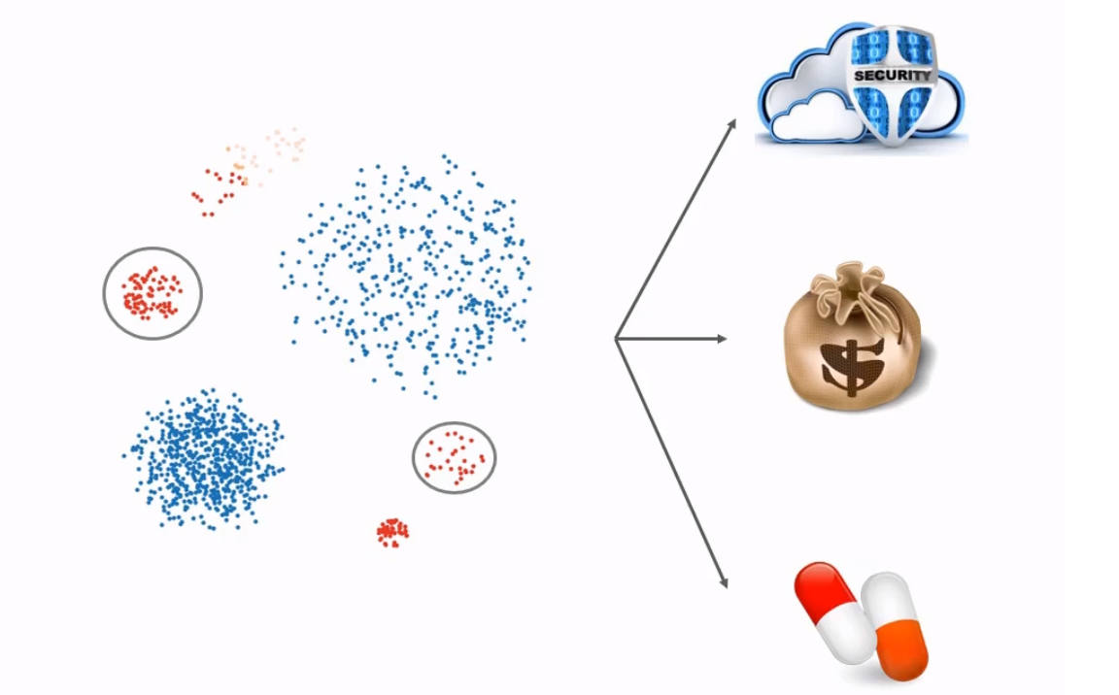
What is Rare Category?
It is a category between the identification of predominant patterns and individual outliers.
These rare categories could represent, for example, computer network intrusions, fraudulent financial transactions etc.,

Slide 3
RCLens
Active Learning Rare Category Identification Algorithm
Highly usable visual environment for iterative rare category discovery and refinement
User-driven rare category identification

Slide 4
Related Work
Similar rare category detection algorithm were developed but most of them failed when dealing with cases having ambiguities.
None of them used active learning based-approach

Slide 5
Modules in RCLens
Data Exploration
Represents raw data via an interactive visualization to assist with data querying and filtering
Feature Selection
Analyzes variances and correlations of data dimensions and guide user selection and investigation process
Rare Category Analysis
The rare categories are visualized one by one through an active learning procedure

Slide 7
Visual Explorers
Data Explorer
Feature Explorer
Category Explorer

Slide 8
The users interface of RCLensconsists of three major explorers: (a) the data explorer, (b) the feature explorer, and (c) the category explorer.
Each explorer is a combination of multiple views. The data explorer consists of two views showing the raw data in a data table and in a parallel
coordinates [11] (1,2), respectively. The feature explorer illustrates the distribution of features in a MDS view (3), the feature variance (4) and the
variance ratios of the components computed based on principle component analysis(PCA) [23] (5), as well as the subspaces formulated by users
(6). Finally, the category explorer consists of a Voronoi diagram illustrating a focused category (7), and a category list (8) showing the categories that
are already labeled by users. A consistent color scheme is used across explorers, with dark red/blue indicating feature values that are above/below
average, respectively. The black circles with numbers are used to highlight individual visualization panels throughout Sec. 4.

Slide 9
Algorithm Evaluation
Metrics
Precision
Recall
Labeling count
Labeling size

Slide 10
Datasets and Results
The datasets used are
Synthetic data (contains 1203 2-dimensional instances, with 204 belonging to rare category)
Page Block (contains 5473 10-dimensional data instances which are separated into 5 classes)
Shuttle (highly skewed public dataset)
KDD Cup’99 (26,289 34-dimensions data instances)
Documents(Benchmark dataset used for testing the text classifiers)

Slide 12
Subspace exploration. (a) The subspace formulated by highly
correlated features and the distribution of data instances. (b) The subspace
formulated by irrelevant features and the corresponding data
distribution.
The instance (i.e., connection) distributions in each of the
Categories shown in the adjacent picture

Slide 13
Conclusion
Results showed RCLens performed better than other methods in ideal conditions and best suited for real world scenarios
Case study showed that workflow is supported in both real world scenarios and well received by the practitioners in the field

Slide 14
Future Work
Improving efficiency of algorithm to support time series data, and designing classification-based rare category detection techniques.
New plugins can be added
More Scalable

Slide 15


